Slide 1

Computer Networks
王廷
华东师范大学 软件工程学院
Email: twang@sei.ecnu.edu.cn
Office: 理科大楼B1116室

Slide 2
Chapter 6 Transport Layer
  Transport Service
  Elements of Transport Protocols
  Congestion Control
  Internet Protocols – UDP
  Internet Protocols – TCP
  Performance Issues
  Delay-Tolerant Networking

Slide 3
The Transport Layer
Responsible for delivering data across networks with the desired reliability or quality
Application
Transport
Network
Link
Physical

Slide 4
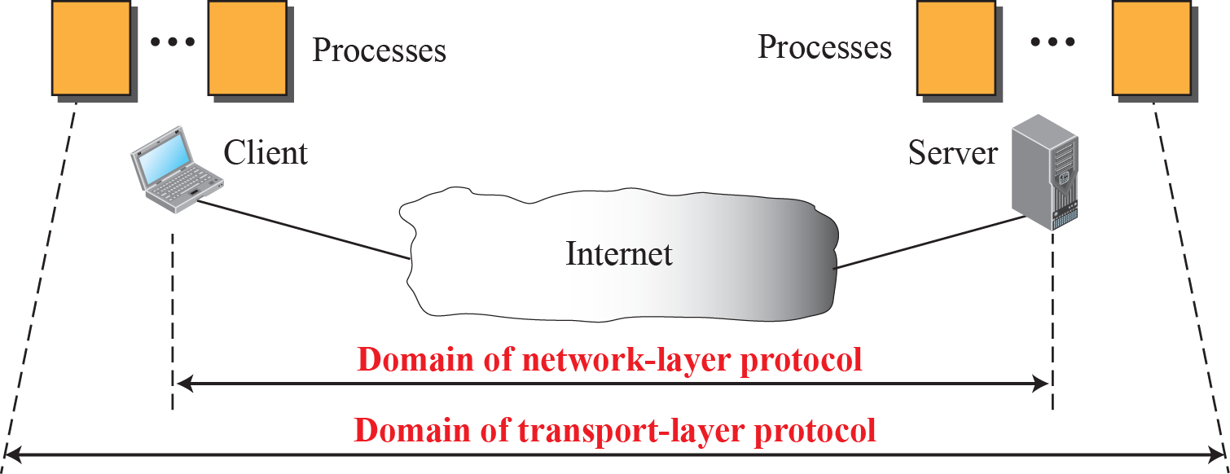
Domain of Transport Layer Protocol

Slide 5
Transport Service
  Services Provided to the Upper Layer »
  Transport Service Primitives »
  Berkeley Sockets »
  Socket Example: Internet File Server »

Slide 6
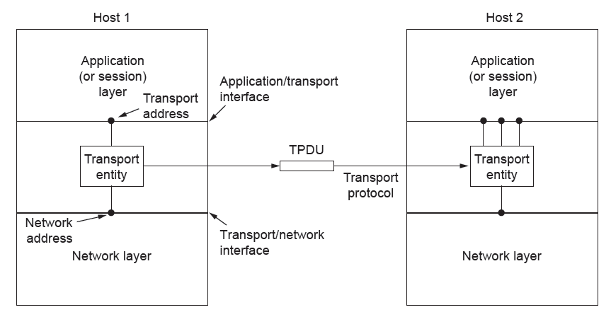
Services Provided to the Upper Layers (1)
Transport layer adds reliability to the network layer
  Offers connectionless (e.g., UDP) and connection-oriented (e.g, TCP) service to applications

Slide 7
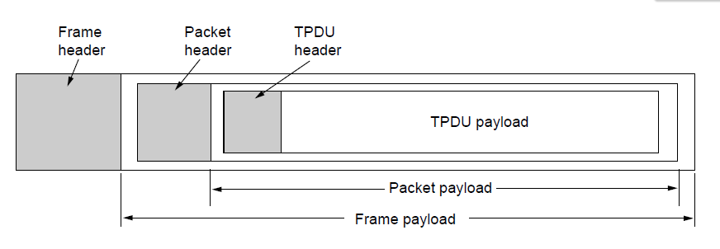
Services Provided to the Upper Layers (2)
Transport layer sends segments in packets (in frames)
Segment
Segment

Slide 8
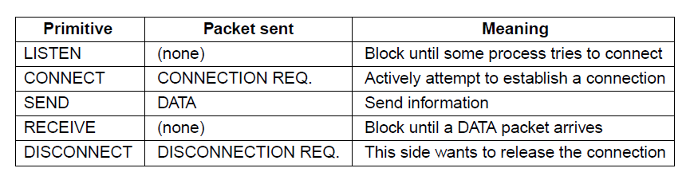
Transport Service Primitives (1)
Primitives that applications might call to transport data for a simple connection-oriented service:
  Client calls CONNECT, SEND, RECEIVE, DISCONNECT
  Server calls LISTEN, RECEIVE, SEND, DISCONNECT
Segment

Slide 9
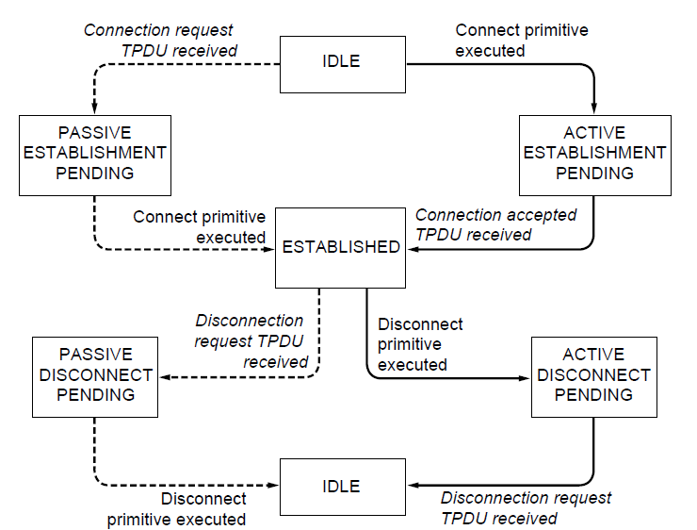
Transport Service Primitives (2)
State diagram for a simple connection-oriented service
Solid lines (right) show client state sequence
Dashed lines (left) show server state sequence
Transitions in italics are due to segment arrivals.

Slide 10
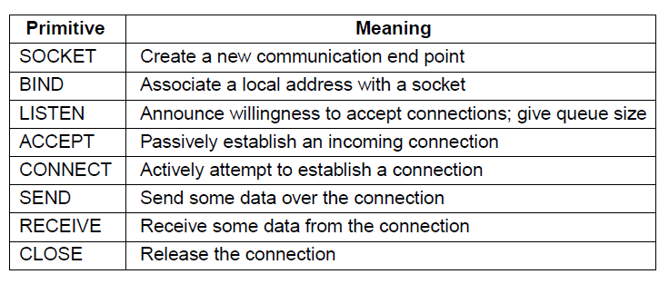
Berkeley Sockets
Very widely used primitives started with TCP on UNIX
  Notion of “sockets” as transport endpoints
  Like simple set plus SOCKET, BIND, and ACCEPT

Slide 11
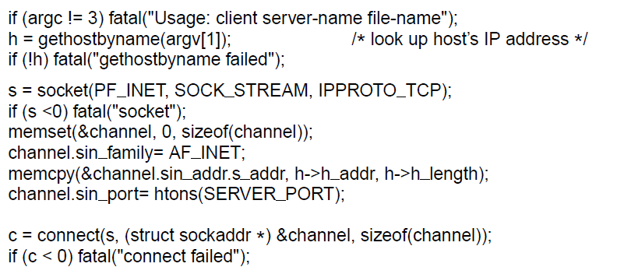
Socket Example – Internet File Server (1)
Client code
. . .
Make a socket
Try to connect
. . .

Slide 12
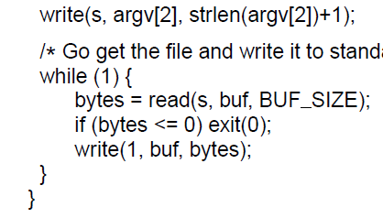
Socket Example – Internet File Server (2)
Client code (cont.)
. . .
Write data (equivalent to send)
Loop reading (equivalent to receive) until no more data; exit implicitly calls close

Slide 13
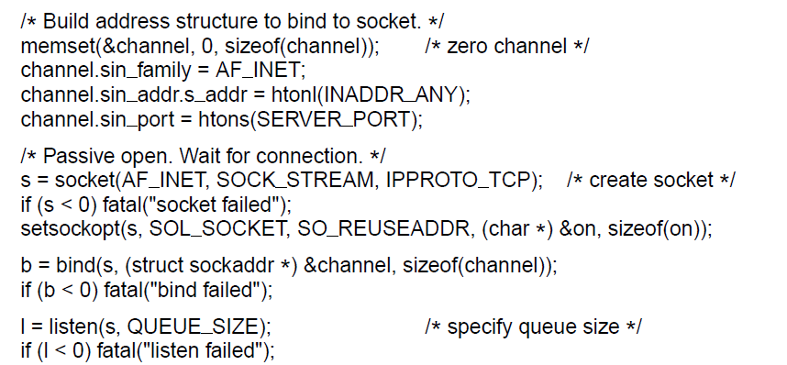
Socket Example – Internet File Server (3)
Server code
. . .
Make a socket
Assign address
Prepare for incoming connections
. . .

Slide 14
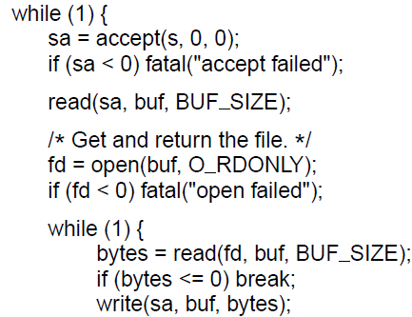
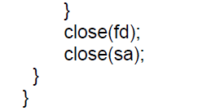
Socket Example – Internet File Server (4)
Server code
. . .
Block waiting for the next connection
Read (receive) request and treat as file name
Write (send) all file data
Done, so close this connection

Slide 15
Elements of Transport Protocols
  Addressing »
  Connection establishment »
  Connection release »
  Error control and flow control »
  Multiplexing »
  Crash recovery »

Slide 16
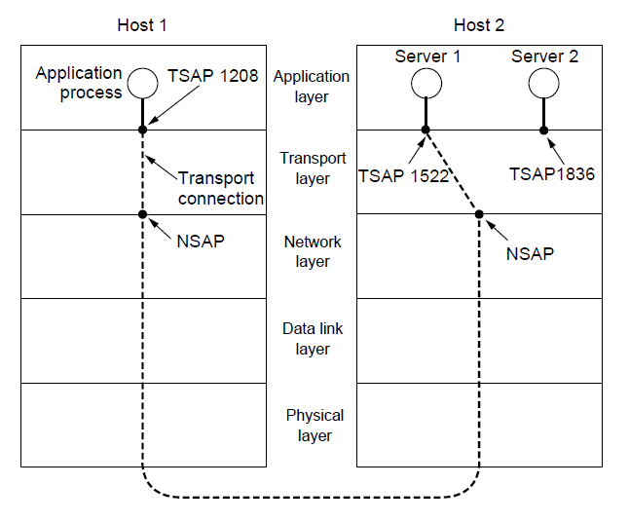
Addressing
Transport layer adds TSAPs (Transport Service Access Point)
Multiple clients and servers can run on a host with a single network (IP) address
TSAPs are ports for TCP/UDP

Slide 17
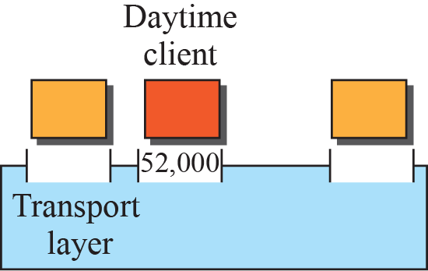
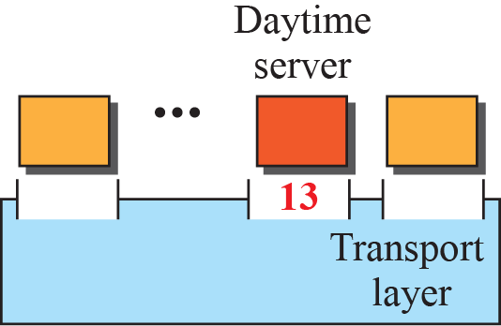
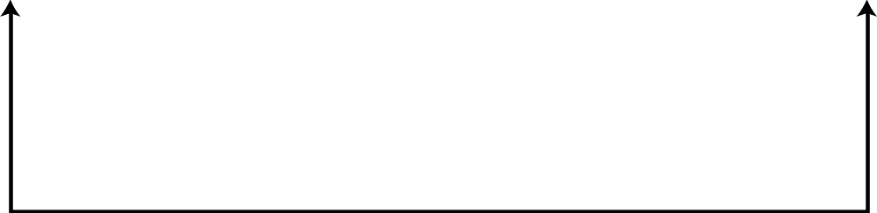

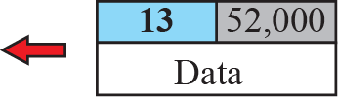
Port Numbers

Slide 18
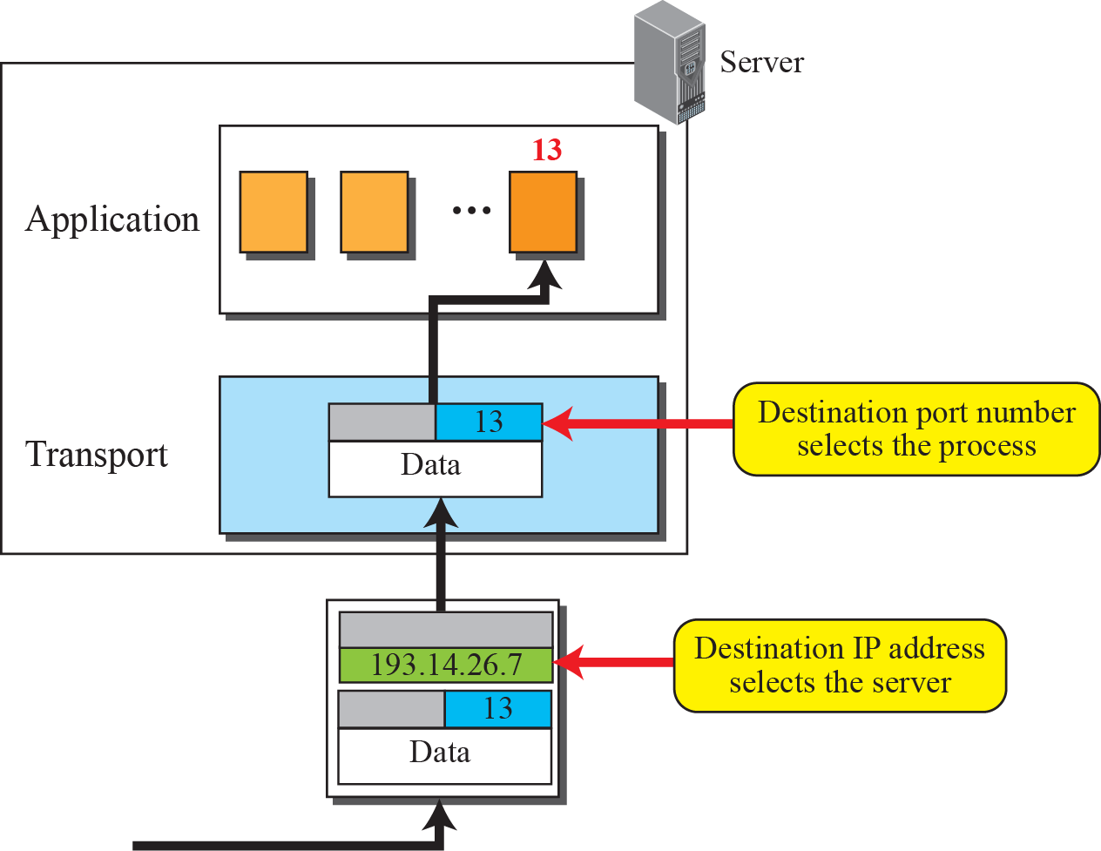
IP Addresses VS. Port Numbers

Slide 19
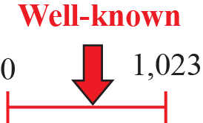
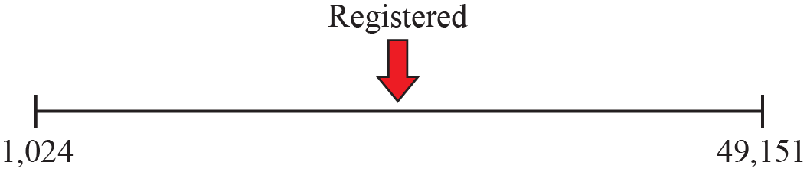
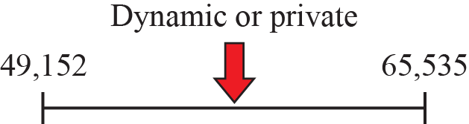
ICANN Ranges
ICANN：The Internet Corporation for Assigned Names and Numbers互联网名称与数字地址分配机构
TCP与UDP段结构中端口地址都是16比特，可以有在0---65535范围内的端口号。
知名端口号为0－1023，由ICANN预留给TCP/UDP使用的端口号，如HTTP 80，POP3 110，FTP 21，SSH 22，Telnet 23, SMTP 25, IMAP3 220，HTTPS 443…
注册端口号为1024－49151，也称为用户端口；大多数TCP/IP实现给临时端口号分配1024-5000之间的端口号。大于5000的端口号是为其他服务器预留的。
剩下的端口号叫动态端口号或私有端口号，为49152－65535。
In UNIX, the well-known ports are stored in a file called /etc/services.

Slide 20
Connection Establishment (1)
Key problem is to ensure reliability even though packets may be lost, corrupted, delayed, and duplicated
  Don’t treat an old or duplicate packet as new
  (Use ARQ and checksums for loss/corruption)
Approach:
  Don’t reuse sequence numbers within twice the MSL (Maximum Segment Lifetime) of 2T=240 secs
  Three-way handshake for establishing connection

Slide 21
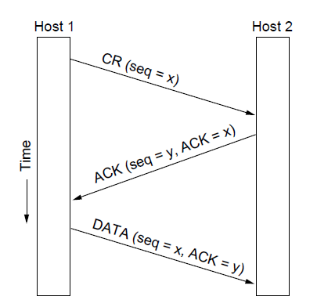
Connection Establishment (2)
Three-way handshake used for initial packet
  Since no state from previous connection
  Both hosts contribute fresh seq. numbers
  CR = Connect Request

Slide 22
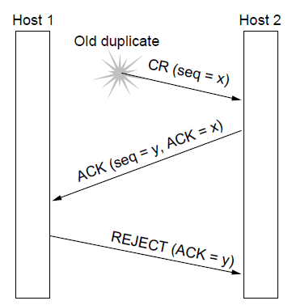
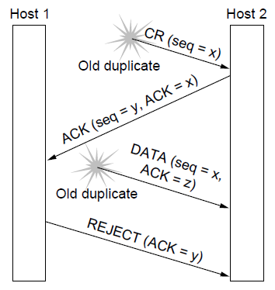
Connection Establishment (4)
Three-way handshake protects against odd cases:
Duplicate CR. Spurious ACK does not connect
Duplicate CR and DATA. Same plus DATA will be rejected (wrong ACK).
a)
X
b)
X
X

Slide 23
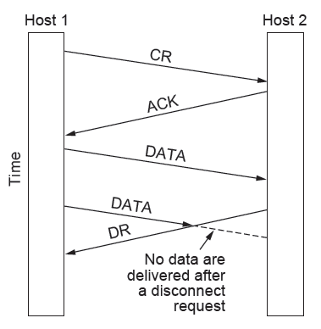
Connection Release (1)
Key problem is to ensure reliability while releasing
Asymmetric release (when one side breaks connection) is abrupt and may lose data
Asymmetric release is the way the telephone system works: when one party hangs up, the connection is broken.
X

Slide 24
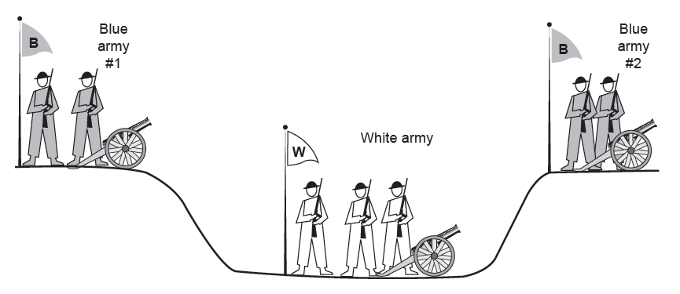
Connection Release (2)
Symmetric release (both sides agree to release) can’t be handled solely by the transport layer
  Two-army problem shows pitfall of agreement
Attack?
Attack?

Slide 25
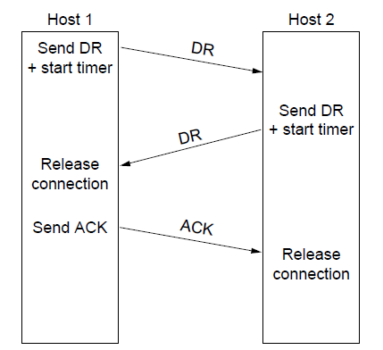
Connection Release (3)
Normal release sequence, initiated by transport user on Host 1
  DR=Disconnect Request
  Both DRs are ACKed by the other side

Slide 26
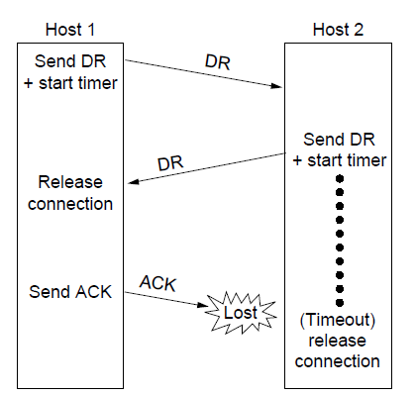
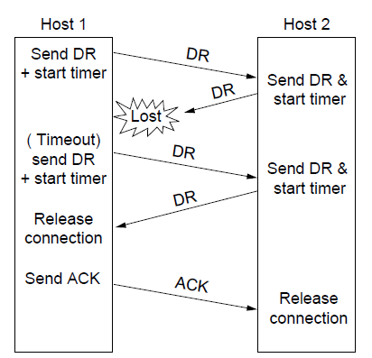
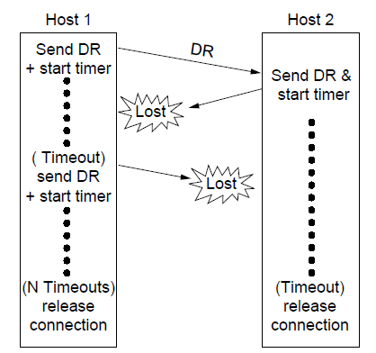
Connection Release (4)
Error cases are handled with timer and retransmission
Final ACK lost, Host 2 times out
Lost DR causes retransmissions
Extreme: Many lost DRs cause both hosts to timeout

Slide 27
Error Control and Flow Control (1)
Foundation for error control is a sliding window (from Link layer) with checksums and retransmissions
Flow control manages buffering at sender/receiver
  Issue is that data goes to/from the network and applications at different times
  Window tells sender available buffering at receiver
  Makes a variable-size sliding window

Slide 28
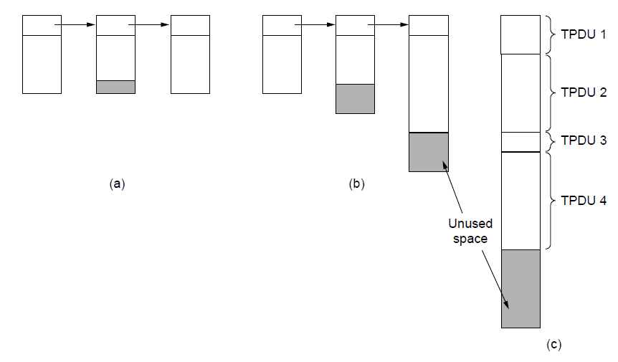
Error Control and Flow Control (2)
Different buffer strategies trade efficiency / complexity
a) Chained fixed-size buffers
b) Chained variable-size buffers
c) One large circular buffer

Slide 29
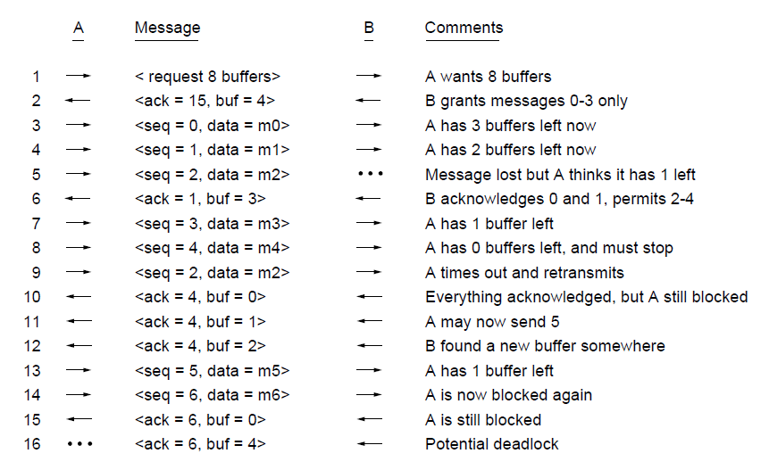
Error Control and Flow Control (3)
Flow control example: A’s data is limited by B’s buffer
B’s Buffer
0
1
2
3
0
1
2
3
0
1
2
3
0
1
2
3
1
2
3
4
1
2
3
4
1
2
3
4
1
2
3
4
1
2
3
4
2
3
4
5
3
4
5
6
3
4
5
6
3
4
5
6
3
4
5
6
7
8
9
10

Slide 30
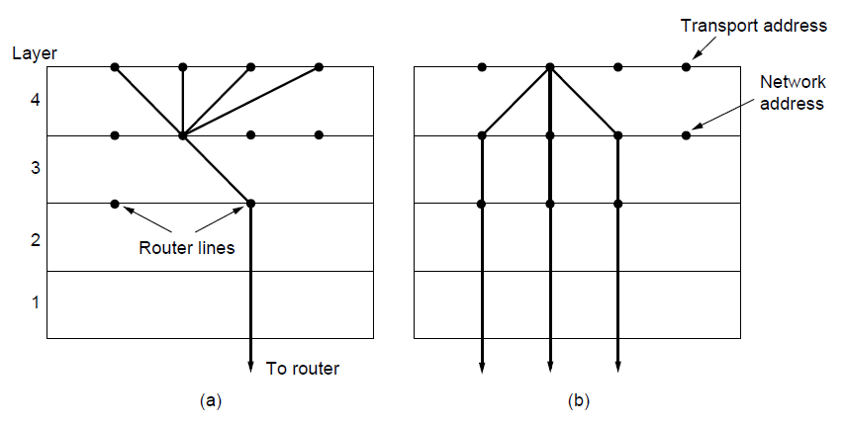
Multiplexing/Demultiplexing
Kinds of transport / network sharing that can occur:
  Multiplexing: connections share a network address
  Inverse multiplexing: addresses share a connection
Multiplexing
Inverse Multiplexing

Slide 31
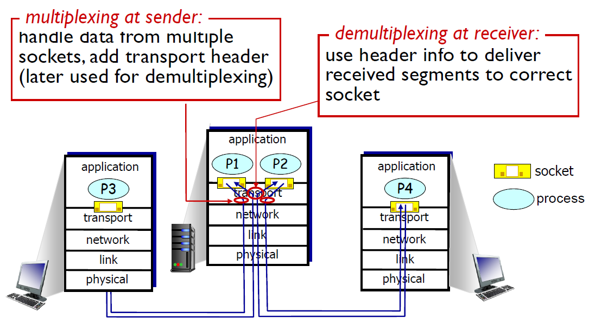
Multiplexing/Demultiplexing

Slide 32
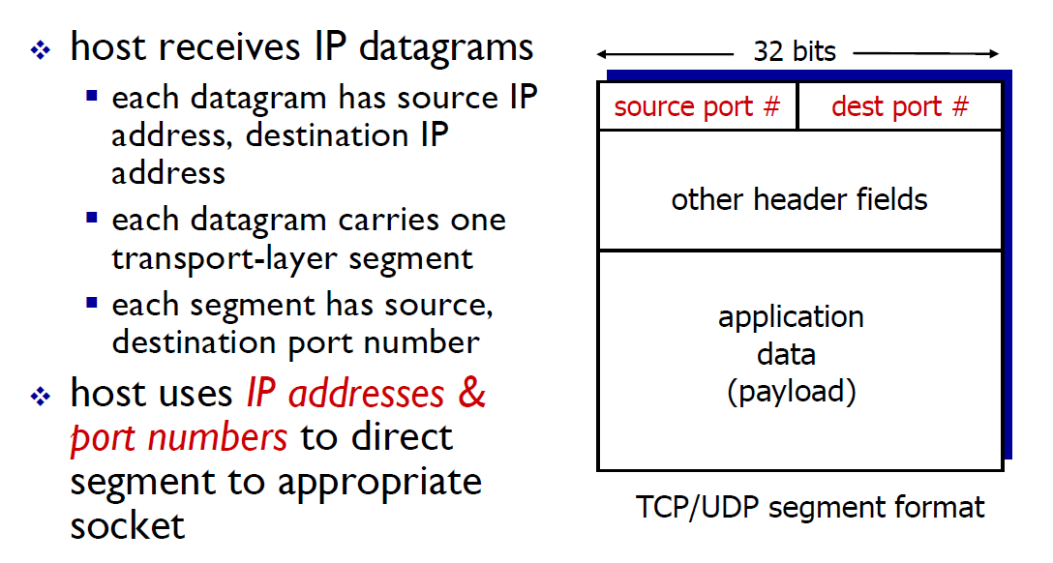
How Demultiplexing Works

Slide 33
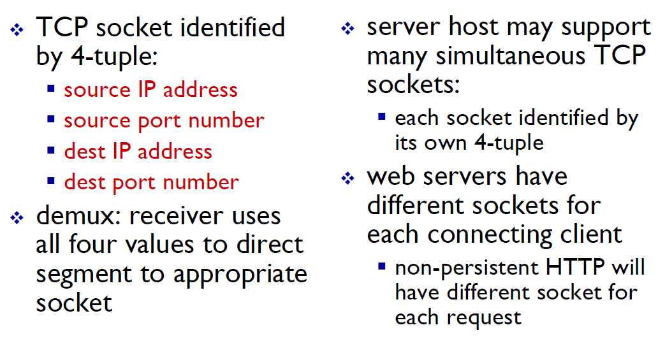
Connection-oriented Demultiplexing

Slide 34
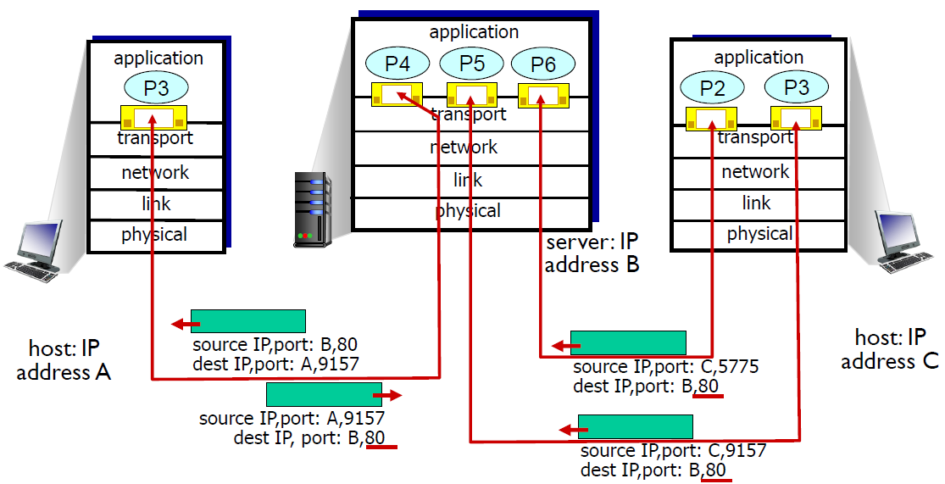
Connection-oriented Demultiplexing: Example
Three segments, all destined to IP address: B, dest port: 80 are demultiplexed to different sockets.

Slide 35
Congestion Control
Two layers are responsible for congestion control:
    Transport layer, controls the offered load [here]
    Network layer, experiences congestion [previous]
  Desirable bandwidth allocation »
  Regulating the sending rate »
  Wireless issues »

Slide 36
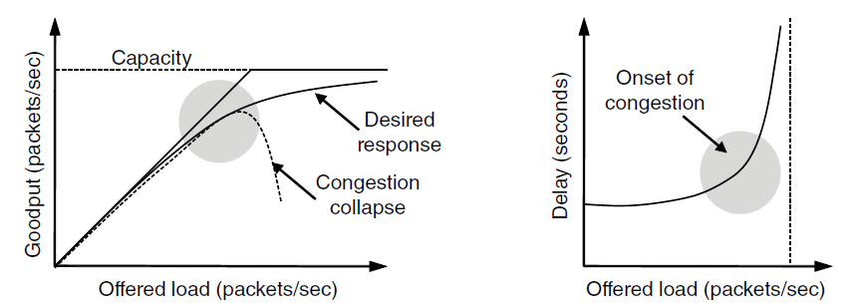
Desirable Bandwidth Allocation (1)
Efficient use of bandwidth gives high goodput, low delay
Goodput rises more slowly than load when congestion sets in
Delay begins to rise sharply when congestion sets in
Notes:
Goodput is useful throughput (minus retransmissions).
The power metric is load/delay. It will rise with load until delay starts to climb rapidly. This is one way to find the knee in the curve that is a good operating point.

Slide 37
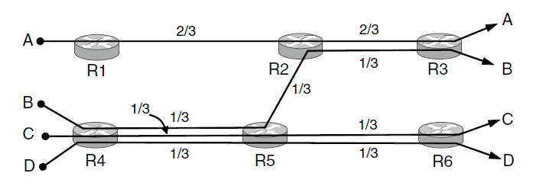
Desirable Bandwidth Allocation (2)
Fair use gives bandwidth to all flows (no starvation)
  Max-min fairness gives equal shares of bottleneck
Max-min Fairness
To find it given a network, imagine “pouring water into the network”
Start with all flows at rate 0;
Increase the flows until there is a new bottleneck in the network;
Hold fixed the rate of the flows that are bottlenecked
Go to step 2 for any remaining flows.
Bottleneck link

Slide 38
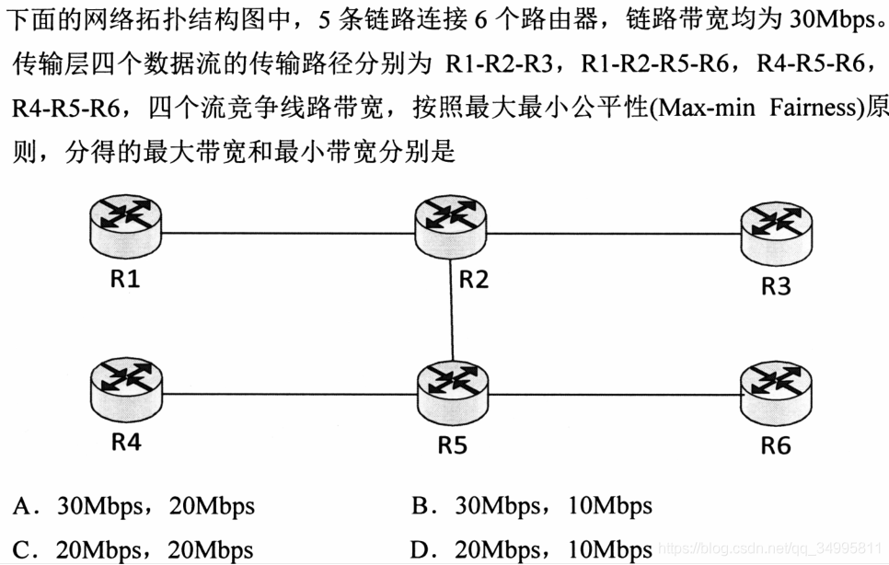

Desirable Bandwidth Allocation (2)
R5-R6两跳含3个数据流，30Mbps三等分后得10Mbps。R1-R2-R3能分得20Mbps
故最高为R1-R2-R3： 20Mbps；其他均为最低： 10Mbps。
选D。

Slide 39
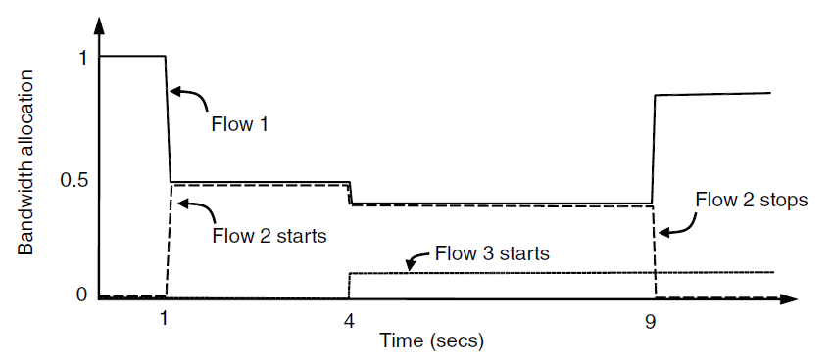
Desirable Bandwidth Allocation (3)
We want bandwidth levels to converge quickly when traffic patterns change
Flow 1 slows quickly when Flow 2 starts
Flow 1 speeds up quickly when Flow 2 stops

Slide 40
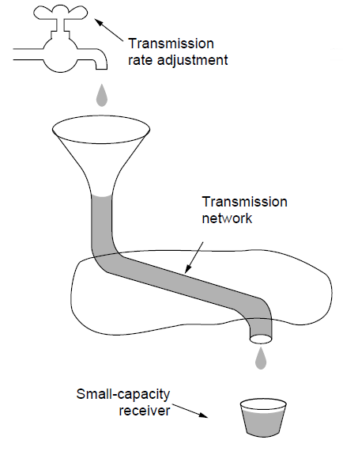
Regulating the Sending Rate (1)
Sender may need to slow down for different reasons:
  Flow control, when the receiver is not fast enough
  Congestion, when the network is not fast enough
A fast network feeding a low-capacity receiver → flow control is needed

Slide 41
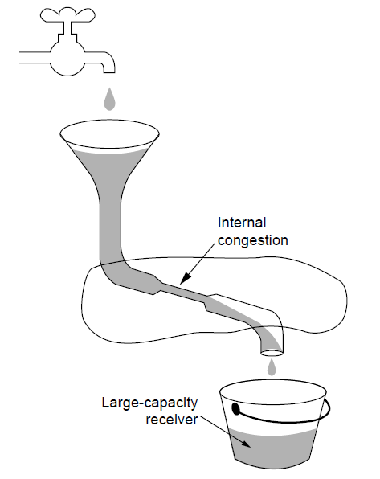
Regulating the Sending Rate (2)
Our focus is dealing with this problem – congestion
A slow network feeding a high-capacity receiver → congestion control is needed

Slide 42
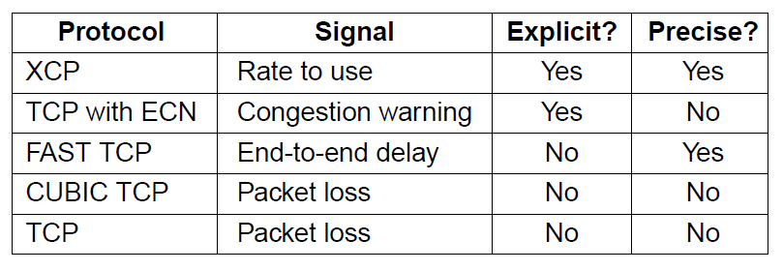
Regulating the Sending Rate (3)
Different congestion signals the network may use to tell the transport endpoint to slow down (or speed up)

Slide 43
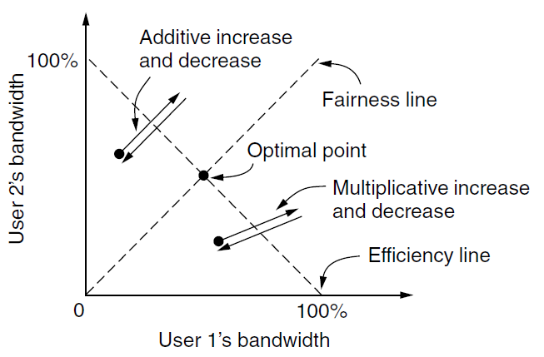
Regulating the Sending Rate (4)
If two flows increase/decrease their bandwidth in the same way when the network signals free/busy they will not converge to a fair allocation
+ /– constant
+/– percentage
Notes:
The game shows two competing flows. The network is efficient when the sum of the flows is 1 unit, shown by the efficiency line. The network is fair when both flows have the same bandwidth, shown by the fairness line (y=x). Each flow increases or decreases their bandwidth periodically depending on whether the network is uncongested or congested. Additive policies change the bandwidth by a constant amount, like 1 Mbps. Additive changes for both users will thus follow a 45 degree line. Multiplicative policies change the bandwidth by a fractional amount, like 10%. Multiplicative changes for both users will thus go along a line towards or away from the origin. With AIAD or MIMD the flows oscillate over the efficiency line but do not become more fair.

Slide 44
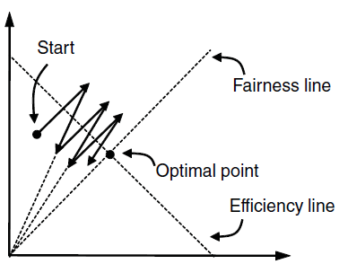
Regulating the Sending Rate (5)
The AIMD (Additive Increase Multiplicative Decrease) control law does converge to a fair and efficient point!
  TCP uses AIMD for this reason
AIMD：“加性增，乘性减” 或者“和式增加，积式减少”
当TCP发送方感受到端到端路径无拥塞时就线性的增加其发送速度，当察觉到路径拥塞时就乘性减小其发送速度。
TCP拥塞控制协议的线性增长阶段被称为避免拥塞。
当TCP发送端收到ACK，并且没有检测到丢包事件时，拥塞窗口加1；当TCP发送端检测到丢包事件后，拥塞窗口除以2。
User 2’s bandwidth
User 1’s bandwidth

Slide 45
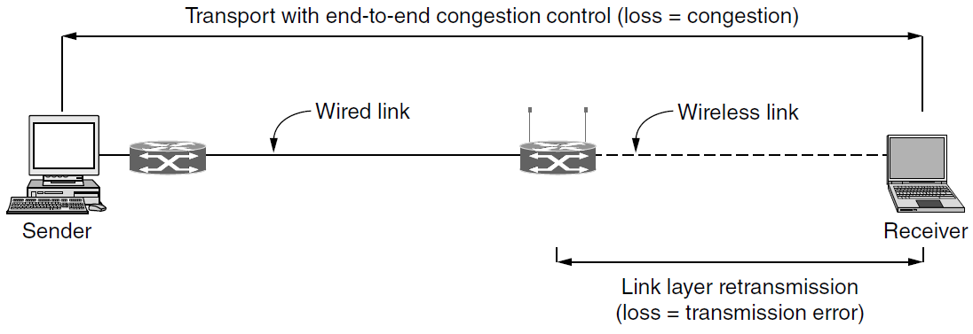
Wireless Issues
Wireless links lose packets due to transmission errors
  Do not want to confuse this loss with congestion
  Or connection will run slowly over wireless links!
Strategy:
  Wireless links use ARQ, which masks errors

Slide 46
Internet Protocols – UDP
  Introduction to UDP »
  Remote Procedure Call »
  Real-Time Transport »

Slide 47
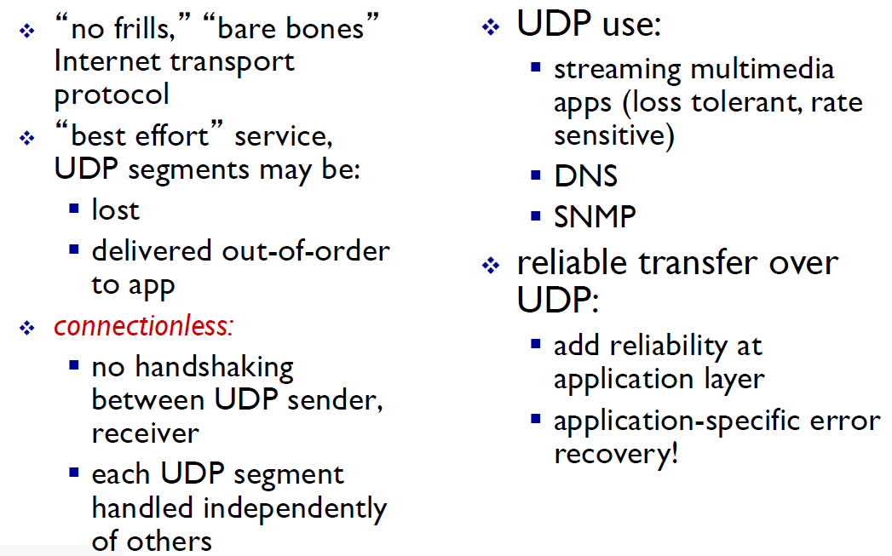
UDP: User Datagram Protocol [RFC 768]
UDP (User Datagram Protocol) is a shim over IP
Notes:
No frills: 无虚饰

Slide 48
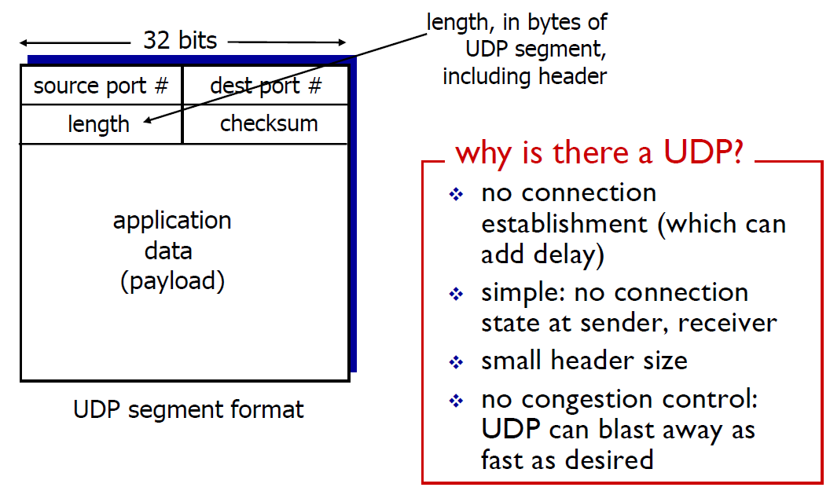
UDP: segment header
Header has ports (TSAPs), length and checksum.
Notes:
TSAP(Transport Service Access Point) 传输服务访问点

Slide 49
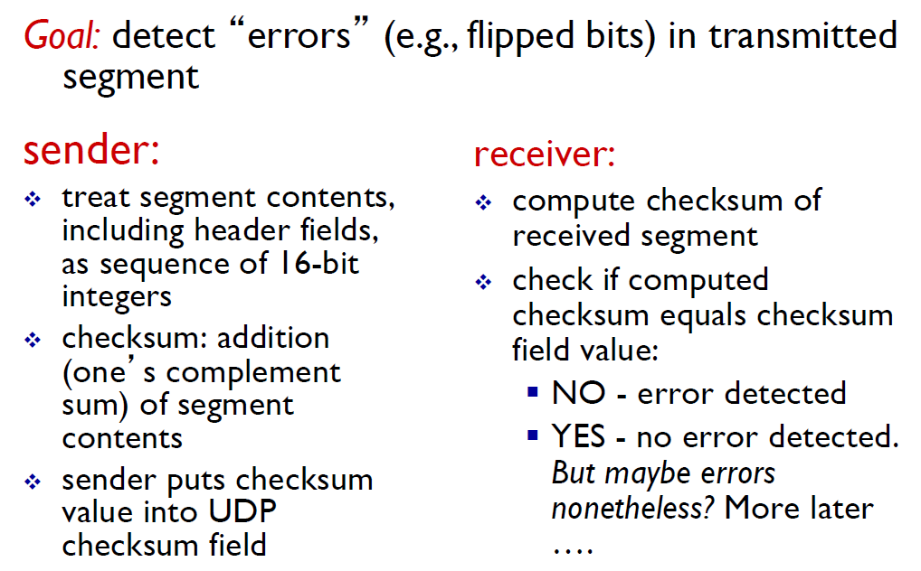
UDP checksum

Slide 50
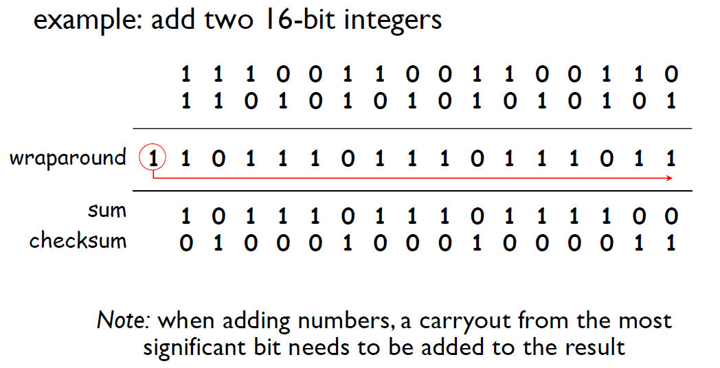
Internet checksum: example

Slide 51


UDP Applications
For the following applications, is UDP preferable? Why?
Short request-reply application
  e.g. DNS (Domain Name System)
Long Message sending application
  e.g. SMTP (Simple Mail Transfer Protocol)
Large file downloading application
  e.g. FTP (File Transfer Protocol)
Real-time interactive application
  e.g. Skype, QQ
总结：如果是每次连接时间较短，或者即时性要求较高，发送内容较少，则采用UDP；而对数据完整性、可靠性要求较高，传输性能要求较低时采用TCP。

Slide 52


Some well-known ports used with UDP and TCP

Slide 53

Exercise
The following is the contents of a UDP header in hexadecimal format.
a. What is the source port number?
b. What is the destination port number?
c. What is the total length of the user datagram?
d. What is the length of the data?
e. Is the packet directed from a client to a server or vice versa?
f. What is the client process?

Slide 54
Solution
a. The source port number is the first four hexadecimal digits (CB84)₁₆ or 52100
b. The destination port number is the second four hexadecimal digits (000D)₁₆ or 13.
c. The third four hexadecimal digits (001C)₁₆ define the length of the whole UDP packet as 28 bytes.
d. The length of the data is the length of the whole packet minus the length of the header, or 28 − 8 = 20 bytes.
e. Since the destination port number is 13 (well-known port), the packet is from the client to the server.
f. The client process is the Daytime.

Slide 55

RPC (Remote Procedure Call)
RPC connects applications over the network with the familiar abstraction of procedure calls
  Stubs package parameters/results into a message
  UDP with retransmissions is a low-latency transport

Slide 56

Real-Time Transport (1)
RTP (Real-time Transport Protocol) provides support for sending real-time media over UDP
  Often implemented as part of the application

Slide 57

Real-Time Transport (2)
RTP header contains fields to describe the type of media and synchronize it across multiple streams
  RTCP sister protocol helps with management tasks
  控制协议RTCP，用于QoS反馈和同步媒体流。相对于RTP来说，RTCP所占的带宽非常小，通常只有5%。
Notes:
V：RTP协议的版本号，占2位，当前协议版本号为2。
P：填充标志，占1位，如果P=1，则在该报文的尾部填充一个或多个额外的八位组，它们不是有效载荷的一部分。
X：扩展标志，占1位，如果X=1，则在RTP报头后跟有一个扩展报头。
CC：CSRC计数器，占4位，指示CSRC 标识符的个数。
M: 标记，占1位，不同的有效载荷有不同的含义，对于视频，标记一帧的结束；对于音频，标记会话的开始。
PT: 有效载荷类型，占7位，用于说明RTP报文中有效载荷的类型，如GSM音频、JPEM图像等。
序列号：占16位，用于标识发送者所发送的RTP报文的序列号，每发送一个报文，序列号增1。接收者通过序列号来检测报文丢失情况，重新排序报文，恢复数据。
时戳(Timestamp)：占32位，时戳反映了该RTP报文的第一个八位组的采样时刻。接收者使用时戳来计算延迟和延迟抖动，并进行同步控制。
同步信源(SSRC)标识符：占32位，用于标识同步信源。该标识符是随机选择的，参加同一视频会议的两个同步信源不能有相同的SSRC。
特约信源(CSRC)标识符：每个CSRC标识符占32位，可以有0～15个。每个CSRC标识了包含在该RTP报文有效载荷中的所有特约信源。
这里的同步信源是指产生媒体流的信源，它通过RTP报头中的一个32位数字SSRC标识符来标识，而不依赖于网络地址，接收者将根据SSRC标识符来区分不同的信源，进行RTP报文的分组。特约信源是指当混合器接收到一个或多个同步信源的RTP报文后，经过混合处理产生一个新的组合RTP报文，并把混合器作为组合RTP报文的SSRC，而将原来所有的SSRC都作为CSRC传送给接收者，使接收者知道组成组合报文的各个SSRC。

Slide 58

Real-Time Transport (3)
Buffer at receiver is used to delay packets and absorb jitter so that streaming media is played out smoothly
Packet 8’s network delay is too large for buffer to help
Constant rate
Variable rate
Constant rate

Slide 59


Real-Time Transport (4)
High jitter, or more variation in delay, requires a larger playout buffer to avoid playout misses
  Propagation delay does not affect buffer size
Buffer
Misses

Slide 60
Internet Protocols – TCP
  The TCP service model »
  The TCP segment header »
  TCP connection establishment »
  TCP connection state modeling »
  TCP sliding window »
  TCP timer management »
  TCP congestion control »

Slide 61

TCP Overview

Slide 62

The TCP Service Model (1)
TCP provides applications with a reliable byte stream between processes; it is the workhorse of the Internet
  Popular servers run on well-known ports

Slide 63


The TCP Service Model (2)
A TCP connection is a byte stream, not a message stream. Message boundaries are not preserved end to end.
Applications using TCP see only the byte stream [right] and not the segments [left] sent as separate IP packets
Four segments, each with 512 bytes of data and carried in an IP packet
2048 bytes of data delivered to application in a single READ call
Notes:
A TCP connection is a byte stream, not a message stream. Message boundaries are not preserved end to end. For example, if the sending process does four 512-byte writes to a TCP stream, these data may be delivered to the receiving process as four 512-byte chunks, two 1024-byte chunks, one 2048-byte chunk (see Fig. 6-35), or some other way. There is no way for the receiver to detect the unit(s) in which the data were written, no matter how hard it tries.

Slide 64

The TCP Segment Header
TCP header includes addressing (ports), sliding window (seq. / ack. number), flow control (window), error control (checksum) and more.
Notes:
1、端口号：用来标识同一台计算机的不同的应用进程。
1）源端口：源端口和IP地址的作用是标识报文的返回地址。
2）目的端口：端口指明接收方计算机上的应用程序接口。
TCP报头中的源端口号和目的端口号同IP数据报中的源IP与目的IP唯一确定一条TCP连接。
2、序号和确认号：是TCP可靠传输的关键部分。序号是本报文段发送的数据组的第一个字节的序号。在TCP传送的流中，每一个字节一个序号。e.g.一个报文段的序号为300，此报文段数据部分共有100字节，则下一个报文段的序号为400。所以序号确保了TCP传输的有序性。确认号，即ACK，指明下一个期待收到的字节序号，表明该序号之前的所有数据已经正确无误的收到。确认号只有当ACK标志为1时才有效。比如建立连接时，SYN报文的ACK标志位为0。
3、首部长度：4bits。由于首部可能含有可选项内容，因此TCP报头的长度是不确定的，报头不包含任何任选字段则长度为20字节，4位首部长度字段所能表示的最大值为1111，转化为10进制为15，15*32/8 = 60，故报头最大长度为60字节。
4、保留：为将来定义新的用途保留，现在一般置0。
5、控制位：URG ACK PSH RST SYN FIN，共6个(加上拥塞控制位CWR和ECE共8位)，每一个标志位表示一个控制功能。
CWR：CWR 标志与后面的 ECE 标志都用于 IP 首部的 ECN 字段，CWR拥塞窗口减少标志被发送主机设置，用来表明它接收到了设置ECE标志的TCP包。
1）URG：紧急指针标志，为1时表示紧急指针有效，为0则忽略紧急指针。
2）ACK：确认序号标志，为1时表示确认号有效，为0表示报文中不含确认信息，忽略确认号字段。
3）PSH：push标志，为1表示是带有push标志的数据，指示接收方在接收到该报文段以后，应尽快将这个报文段交给应用程序，而不是在缓冲区排队。
4）RST：重置连接标志，用于重置由于主机崩溃或其他原因而出现错误的连接。或者用于拒绝非法的报文段和拒绝连接请求。
5）SYN：同步序号，用于建立连接过程，在连接请求中，SYN=1和ACK=0表示该数据段没有使用捎带的确认域，而连接应答捎带一个确认，即SYN=1和ACK=1。
6）FIN：finish标志，用于释放连接，为1时表示发送方已经没有数据发送了，即关闭本方数据流。
6、窗口：滑动窗口大小，用来告知发送端接受端的缓存大小，以此控制发送端发送数据的速率，从而达到流量控制。窗口大小时一个16bit字段，因而窗口大小最大为65535。
7、校验和：奇偶校验，此校验和是对整个的 TCP 报文段，包括 TCP 头部和 TCP 数据，以 16 位字进行计算所得。由发送端计算和存储，并由接收端进行验证。
8、紧急指针：只有当 URG 标志置 1 时紧急指针才有效。紧急指针是一个正的偏移量，和顺序号字段中的值相加表示紧急数据最后一个字节的序号。 TCP 的紧急方式是发送端向另一端发送紧急数据的一种方式。
9、选项和填充：最常见的可选字段是最长报文大小，又称为MSS（Maximum Segment Size），每个连接方通常都在通信的第一个报文段（为建立连接而设置SYN标志为1的那个段）中指明这个选项，它表示本端所能接受的最大报文段的长度。选项长度不一定是32位的整数倍，所以要加填充位，即在这个字段中加入额外的零，以保证TCP头是32的整数倍。
10、数据部分： TCP 报文段中的数据部分是可选的。在一个连接建立和一个连接终止时，双方交换的报文段仅有 TCP 首部。如果一方没有数据要发送，也使用没有任何数据的首部来确认收到的数据。在处理超时的许多情况中，也会发送不带任何数据的报文段。
CWR and ECE are used to signal congestion when ECN (Explicit Congestion Notification) is used, as specified in RFC 3168. ECE is set to signal an ECN-Echo to a TCP sender to tell it to slow down when the TCP receiver gets a congestion indication from the network. CWR is set to signal Congestion Window Reduced from the TCP sender to the TCP receiver so that it knows the sender has slowed down and can stop sending the ECN-Echo.

Slide 65


About Sequence Number and Window Size

Slide 66


About Sequence Number and Window Size
Make sure the sequence number does not wrap around within the maximum segment lifetime (MSL). This depends on how fast data can be transmitted over the Internet.
  For 32-bit sequence number space (TCP), IETF define an extension to extend the sequence number space to protect against the sequence number wrapping around.
Keep the pipe full: the bandwidth delay product indicates how big Window Size (Advertised Window) field needs to be.
  For 16-bit Window Size field (TCP), only 64KB is allowed. Solution: also extension to TCP.

Slide 67
Exercise 1
Suppose TCP operates over a 40-Gbps STS-768 link.
(a) Assuming TCP could utilize the full bandwidth continuously, how long would it take the sequence numbers to wrap around completely?
(b) Suppose an added 32-bit timestamp field which increments 1000 times during the wraparound time you found above. How long would it take for the timestamp to wrap around?
Solution:
(a) 2³² Bytes / (40/8) GBps = 859 ms
(b) 1000 ticks in 859 ms, 1 tick in 859 μs. 2³² * 859 μs = 3.7Ms, approximately 43 days

Slide 68
Exercise 2
You are hired to design a reliable byte-stream protocol that uses a sliding window (like TCP). This protocol will run over a 1-Gbps network. The RTT of the network is 140 ms, and the maximum segment lifetime is 60 seconds. How many bits would you include in the AdvertisedWindow and SequenceNum fields of your protocol header?
Solution:
The AdvertisedWindow should be large enough to keep the pipe full.
  Bandwidth Delay (RTT) Product = 1Gbps * 140 ms = 17.5 Mbytes
  AdvertisedWindow filed: 25 bits
The sequence number must not wrap around within the maximum segment lifetime.
  1 Gbps * 60 s = 60 Gb = 7.5 GB
  SequenceNum filed: 33 bits

Slide 69

TCP round trip time (RTT), timeout

Slide 70


TCP round trip time (RTT), timeout

Slide 71

TCP round trip time (RTT), timeout

Slide 72

Connection Management

Slide 73

Agreeing to establish a connection

Slide 74

Agreeing to establish a connection
Notes:
如果客户端一开始发送的连接请求超时，并且放弃了连接。这时服务端有可能会收到那个超时的包，如果是两次握手就可建立连接，那么此时对于服务端来说连接就是成功的，操作系统会创建新的线程和分配内存来处理后面的通信，而服务端发送给客户端的确认应答（也就是第二次握手）却超时或者直接丢了，可是此时客户端都放弃连接了，不会再有通信了，白白浪费服务器资源。

Slide 75

TCP Connection Establishment: three-way handshake
TCP sets up connections with the three-way handshake
  Release is symmetric, also as described before
Normal case
Simultaneous connect
Notes:
One slight difference from before: the receiver echoes ACK+1 rather than simply ACK to show that it received and understood the connection request.
Terminology: connection request is a SYN, for synchronize, disconnect request is a FIN for finish.

Slide 76










Connection Establishment using Three-way Handshaking

Slide 77










Data Transfer

Slide 78







Connection Termination using three-way handshaking

Slide 79



Connection Termination using four-way handshaking
z

Slide 80

Connection Termination using four-way handshaking

Slide 81

TCP Connection State Modeling (1)
The TCP connection finite state machine has more states than our simple example from earlier.

Slide 82

TCP Connection State Modeling (2)
Solid line is the normal path for a client.
Dashed line is the normal path for a server.
Light lines are unusual events.
Transitions are labeled by the cause and action, separated by a slash.
Notes:
Exercise: using two instances of this, follow the path of a normal connection from a three-way handshake (both sides should move from closed to established using socket calls and packet exchanges) to teardown (both sides should move to closed at bottom). Ignore packet loss as it is not covered here. Then try a simultaneous open, etc.

Slide 83

A Common Scenario

Slide 84

TCP Sliding Window (1)
TCP adds flow control to the sliding window as before
  ACK + WIN is the sender’s limit
Notes:
To see why the figure is correct about where the data lies in the buffer note that it is a circular buffer. Data is put in from left to right then starts at the left edge again (bottom). Similarly, data is read out left to right (second from bottom).

Slide 85

TCP Sliding Window (2)
Need to add special cases to avoid unwanted behavior
  E.g., silly window syndrome [below]
Receiver application reads single bytes, so sender always sends one byte segments
Notes:
接收端和发送端速率不匹配的状况下，TCP协议栈滑动窗口动态调整机制产生的一种问题 叫糊涂窗口综合症(silly window syndrome)
These sort of things problems crop up in practice as being part of the mechanisms we have described so far. They usually call for modified sliding window / flow control rules in special cases. Solution for silly window syndrome is that receiver should not send window updates for tiny buffer openings like “one byte available”. It should wait until a whole segment can be buffered to avoid this.

Slide 86

TCP Timer Management
TCP estimates retransmit timer from segment RTTs
  Tracks both average and variance (for Internet case)
  Timeout is set to average plus 4 x variance
LAN case – small, regular RTT
Internet case – large, varied RTT
Notes:
RTT is round-trip time, a measure of delay that can be easily computed at one end without synchronized clocks.
Average is computed with an EWMA, exponentially weighted moving average that is very simple: new value = alpha x old value + (1-alpha) x sample. Alpha is 7/8, say.
Similarly for estimating the variance. TCP actually computes the deviation from the mean with another EWMA.

Slide 87
Internet Protocols – TCP
  The TCP service model »
  The TCP segment header »
  TCP connection establishment »
  TCP connection state modeling »
  TCP sliding window »
  TCP timer management »
  TCP congestion control »
    Principles of congestion control
    TCP congestion control

Slide 88

Principles of congestion control

Slide 89

Causes/costs of congestion: scenario 1

Slide 90

Causes/costs of congestion: scenario 2

Slide 91

Causes/costs of congestion: scenario 2

Slide 92

Causes/costs of congestion: scenario 2

Slide 93

Causes/costs of congestion: scenario 2

Slide 94

Causes/costs of congestion: scenario 2

Slide 95

Causes/costs of congestion: scenario 2

Slide 96

Causes/costs of congestion: scenario 3

Slide 97

Causes/costs of congestion: scenario 3

Slide 98

Approaches towards congestion control

Slide 99
TCP Congestion Control (1)
TCP uses AIMD with loss signal to control congestion
  Implemented as a congestion window (cwnd) for the number of segments that may be in the network
  Uses several mechanisms that work together。
  TCP拥塞控制主要有四种算法：慢开始（slow-start）、拥塞避免（Congestion Avoidance）、快重传（Fast Retransmit）、快恢复（Fast Recovery）。
Name | Mechanism | Purpose
ACK clock | Congestion window (cwnd) | Smooth out packet bursts
Slow-start | Double cwnd each RTT | Rapidly increase send rate to reach roughly the right level
Additive Increase | Increase cwnd by 1 packet each RTT | Slowly increase send rate to probe at about the right level
Fast retransmit / recovery | Resend lost packet after 3 duplicate ACKs; send new packet for each new ACK | Recover from a lost packet without stopping ACK clock

Slide 100

TCP Congestion Control (2)
Congestion window controls the sending rate
  Rate is cwnd / RTT; window can stop sender quickly
  ACK clock (regular receipt of ACKs) paces traffic and smoothes out sender bursts
ACKs pace new segments into the network and smooth bursts

Slide 101

TCP Congestion Control (3)
Slow start grows congestion window exponentially
  Doubles every RTT while keeping ACK clock going
Increment cwnd for each new ACK
Notes:
It’s only slow compared to jumping to a large window immediately, which was how it used to work when slow-start was invented.

Slide 102

TCP Congestion Control (4)
Additive increase grows cwnd slowly
  Adds 1 every RTT
  Keeps ACK clock
ACK

Slide 103

TCP Congestion Control (5)
Slow start followed by additive increase (TCP Tahoe)
  Threshold is half of previous loss cwnd
Loss causes timeout; ACK clock has stopped so slow-start again
Notes:
Slow-start switches to additive increase at the slow-start threshold, which is set to be half the cwnd at the previous data loss. (First loss that finds this threshold is not shown.)
With both slow-start and additive increase the connection spends much of its time with a reasonable cwnd. But we have to start over after loss because by the time it is detected the ACK clock has stopped.

Slide 104

TCP Congestion Control (6)
With fast recovery, we get the classic sawtooth (TCP Reno)
  Retransmit lost packet after 3 duplicate ACKs
  New packet for each dup. ACK until loss is repaired
The ACK clock doesn’t stop, so no need to slow-start
Notes:
With fast recovery, the packet loss is detected with three duplicate ACKs, the lost packet (next to be ACKed) is retransmitted (fast retransmit), the cwnd is halved, and then a new packet is sent for each acknowledgment that is received. Eventually the ack will jump forward when the retransmission fills the hole, and at that point we synchronize.

Slide 105

TCP Congestion Control (7)
SACK (Selective ACKs) extend ACKs with a vector to describe received segments and hence losses
  Allows for more accurate retransmissions / recovery
No way for us to know that 2 and 5 were lost with only ACKs

Slide 106
Differences between Flow Control and Congestion Control
流量控制：
是为了控制发送方的发送速率，让发送方的发送速率不要太快，确保接收方来得及接收。具体来说，TCP是利用滑动窗口机制来实现对发送方的流量控制，接收方通过在发送的确认报文中填写窗口字段来控制发送方窗口大小，从而限制发送方的发送速率。
拥塞控制
是防止过多的数据注入网络中，从而确保网络中的路由器或链路不致过载。拥塞控制是一个全局性的过程，和流量控制不同，流量控制指点对点通信量的控制。

Slide 107
Performance Issues
Many strategies for getting good performance have been learned over time
  Performance problems »
  Measuring network performance »
  Host design for fast networks »
  Fast segment processing »
  Header compression »
  Protocols for “long fat” networks »

Slide 108
Performance Problems
Unexpected loads often interact with protocols to cause performance problems
  Need to find the situations and improve the protocols
Examples:
  Broadcast storm: one broadcast triggers another
  Synchronization: a building of computers all contact the DHCP server together after a power failure
  Tiny packets: some situations can cause TCP to send many small packets instead of few large ones

Slide 109
Measuring Network Performance
Measurement is the key to understanding performance – but has its own pitfalls.
Example pitfalls:
  Caching: fetching Web pages will give surprisingly fast results if they are unexpectedly cached
  Timing: clocks may over/underestimate fast events
  Interference: there may be competing workloads

Slide 110
Host Design for Fast Networks
Poor host software can greatly slow down networks.
Rules of thumb for fast host software:
  Host speed more important than network speed
  Reduce packet count to reduce overhead
  Minimize data touching
  Minimize context switches
  Avoiding congestion is better than recovering from it
  Avoid timeouts
Notes:
拇指规则(RULE OF THUMB) ，中文又译为“大拇指规则 ”，又叫”经验法则“，是一种可用于许多情况的简单的，经验性的，探索性的但不是很准确的原则。

Slide 111

Fast Segment Processing (1)
Speed up the common case with a fast path [pink]
  Handles packets with expected header; OK for others to run slowly
Segment
segment

Slide 112

Fast Segment Processing (2)
Header fields are often the same from one packet to the next for a flow; copy/check them to speed up processing
TCP header fields that stay the same for a one-way flow (shaded)
IP header fields that are often the same for a one-way flow (shaded)

Slide 113
Header Compression
Overhead can be very large for small packets
  40 bytes of header for RTP/UDP/IP VoIP packet
  Problematic for slow links, especially wireless
Header compression mitigates this problem
  Runs between Link and Network layer
  Omits fields that don’t change or change predictably
    40 byte TCP/IP header → 3 bytes of information
  Gives simple high-layer headers and efficient links

Slide 114

Protocols for “Long Fat” Networks (1)
Networks with high bandwidth (“Fat”) and high delay (“Long”) can store much information inside the network
  Requires protocols with ample buffering and few RTTs, rather than reducing the bits on the wire
Starting to send 1 Mbit
San Diego → Boston
20ms after start
40ms after start

Slide 115

Protocols for “Long Fat” Networks (2)
You can buy more bandwidth but not lower delay
  Need to shift ends (e.g., into cloud) to lower further
Propagation delay
Minimum time to send and ACK a 1-Mbit file over a 4000-km line

Slide 116
Delay Tolerant Networking
DTNs (Delay Tolerant Networks) store messages inside the network until they can be delivered
  DTN Architecture »
  Bundle Protocol »

Slide 117

DTN Architecture (1)
Messages called bundles are stored at DTN nodes while waiting for an intermittent link to become a contact
  Bundles might wait hours, not milliseconds in routers
  May be no working end-to-end path at any time
Notes:
在DTN术语中，一个消息被称为是一个bundle。DTN结点包含有存储器(像磁盘或闪存一样典型的连续存储器)。它们存储这些bundle，直到链路可得，然后转发这些bundle。这些链路间歇性地工作。图1展示了五个当前没有工作的间歇性链路，以及两个正在工作的链路。一个工作链路叫做一个contact。图1也显示了存储在两个DTN结点处的bundle，它们正等着被contact发送出去。使用这种方法，这些bundle被从源站到目的站的contact延迟了。

Slide 118

DTN Architecture (2)
Example DTN connecting a satellite to a collection point
Notes:
What is the advantage of using a DTN here versus a traditional wireless network? There may be no working path sometimes (satellite has no contact, ground station backhaul broken) or the path might not exist for long enough to send a but satellite software would still like to “send images” without worrying about these issues even if the network stores them. Storing bundles at ground stations also decouples the satellite link from the ground backhaul. If the wireless is faster then images may be stored in the ground station.

Slide 119

Bundle Protocol (1)
The Bundle protocol uses TCP or other transports and provides a DTN service to applications
Notes:
Why the convergence layer? We want to define just one Bundle protocol to run over TCP or other transport layers (SCTP, etc.). The transport protocols are not going to have exactly the same interfaces, so they will not fit exactly with the bundle protocol. Convergence layers are the glue that join the interfaces together.

Slide 120

Bundle Protocol (2)
Features of the bundle message format:
    Dest./source add high-level addresses (not port/IP)
    Custody transfer shifts delivery responsibility
    Dictionary provides compression for efficiency

Slide 121

Homework
Consider the following plot of TCP congestion window size as a function of the transmission. Explain all your answers below.
Which version of TCP is this, Tahoe or Reno?
Identify the intervals of time when TCP slow start is operating.
Identify the intervals of time when TCP congestion avoidance is operating.
After the 16th transmission round, is segment loss detected by a triple duplicate ACK or by a timeout?
After the 22nd transmission round, is segment loss detected by a triple duplicate ACK or by a timeout?
What is the initial value of Threshold at the first transmission round?
What is the value of Threshold at the 18th transmission round?
What is the value of Threshold at the 24th transmission round?
During what transmission round is the 70th segment sent?
42
32
26

Slide 122
End
Chapter 6
Computer Networks, Chapter 6 The Transport Layer

Slide 123
Q & A

